Slide 1

FINANCIAL DECISION MAKING

Slide 2
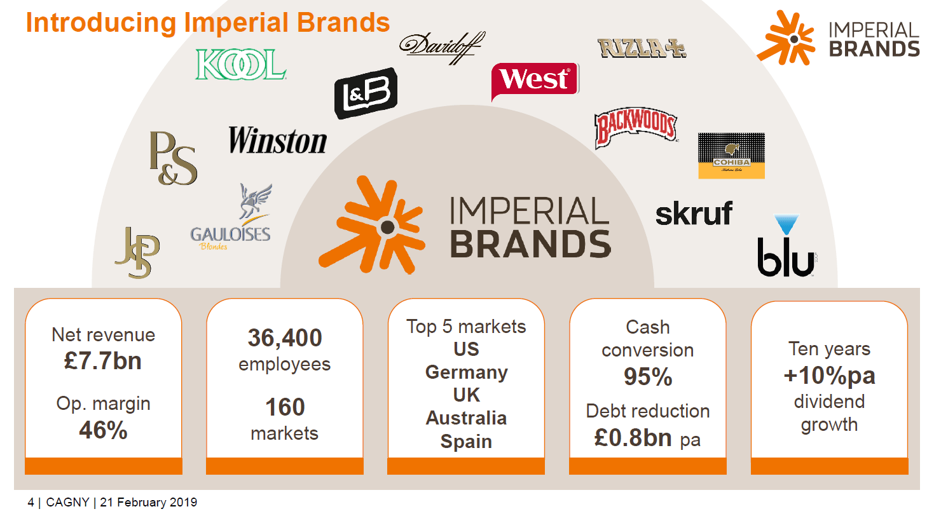
INTRODUCTION
Revenue around 3,256.2 crores GBP (2020) (Finance.yahoo.com, 2023)
Organization was founded in 1901
operating business activity in approximately 30 countries
Notes:
Imperial Brands PLC is a multinational UK based organization operating business activity by producing and selling tobacco products. This organization has established itself as an international cigarette company among customers. Organization was founded in 1901 and generated revenue around 3,256.2 crores GBP (2020) (Finance.yahoo.com, 2023). Using various activity organizational approaches for continuous productivity and cost management has been evaluated by analyzing financial reports of the last 5 years. This organization has been operating business activity in approximately 30 countries which provided excellent opportunities for revenue and maintained excellence in portability development. Organization activity has been performing based on the leadership approach which is presenting information about marketing strategies and decision making ability for growth. Evaluation of financial report going to describe organizational performance in the last 5 years and provide perspective of further business activity.

Slide 3
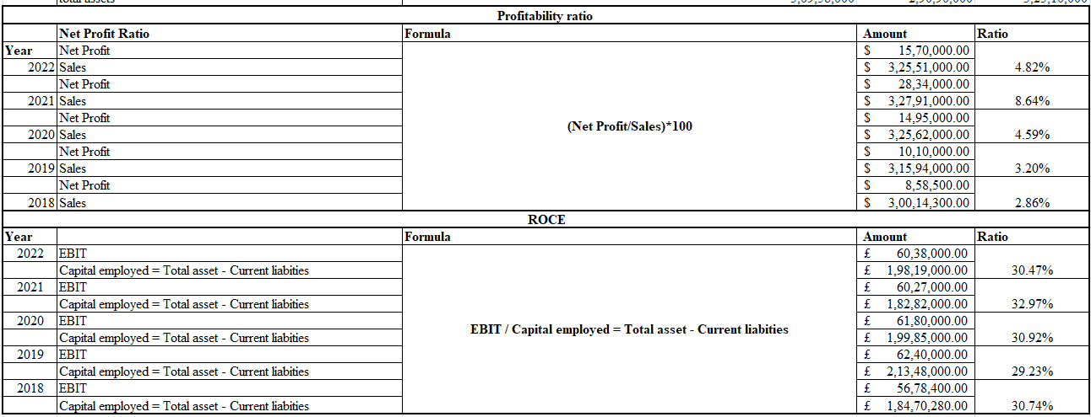
RATIO ANALYSIS AND INTERPRETATION OF FINANCIAL INFORMATION
net profit margin has described continuous growth up to financial year 2021 because of NP margin 8.64%
organization has been identified as 30.74 percent in the financial year 2018 which has been projected to increase to 32.97%
organizational success in financial planning and also provides it with sufficient flow of resources for business expansion (Chang et al. 2019)
Notes:
Profitability ratio has describing information regarding Net profit margin and return on capital employed. Evaluation of net profit margin has described continuous growth up to financial year 2021 because of NP margin 8.64%, whereas it has fallen down to 4.8 to percentage in financial year 2022 (Vogel, 2020). Revenue volume of the organization has fallen down in financial year 2022 that is the reason behind the deficit in net profit margin.
Return on capital employed of the organization has been identified as 30.74 percent in the financial year 2018 which has been projected to increase to 32.97% in the financial year 2021. This positive growth has been considered as an organizational success in financial planning and also provides it with sufficient flow of resources for business expansion (Chang et al. 2019).

Slide 4
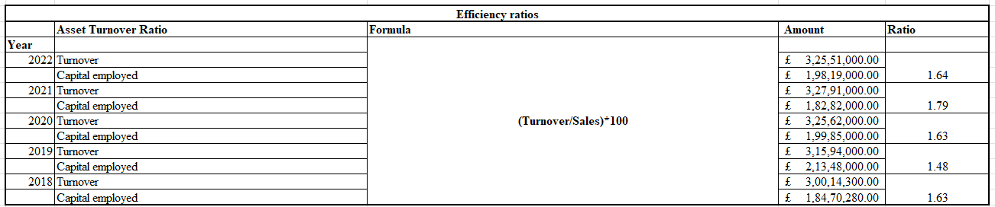
EFFICIENCY RATIOS
assets turnover ratio which is present 1.63 times in financial year 2018.
Current performance of the organization presented information regarding 1.64 times assets turnover ratio in financial year 2022 (Fisu et al. 2020)
Business expansion whereas assets turnover ratio has not been developed in the last 5 years (Tao et al. 2022)
Notes:
Imperial brand PLC efficiency has been evaluated by identification of assets turnover ratio which is present 1.63 times in financial year 2018. Current performance of the organization presented information regarding 1.64 times assets turnover ratio in financial year 2022 which is producing organizational performance effectively in productivity and profitability the development using assets volume (Fisu et al. 2020). According to asset turnover, organizational performance evaluates continuous population of business activity with optimisation of total assets providing excellence in Business expansion whereas assets turnover ratio has not been developed in the last 5 years (Tao et al. 2022).

Slide 5
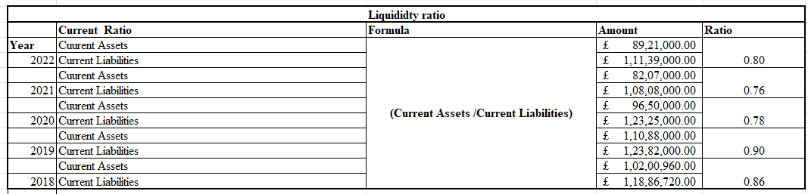
LIQUIDITY RATIO
Current ratio analysis that presented 0.80 times in financial year 2022
According to the prosperity of liquidity present organizational financial operational activity
liquidity was 0.86 times in financial year 2018
Notes:
Financial liquidity of Imperial brand has been evaluated by current ratio analysis that presented 0.80 times in financial year 2022 where it was 0.86 times in financial year 2018. According to the prosperity of liquidity present organizational financial operational activity has been struggling due to lack of sufficient financial resources.

Slide 6
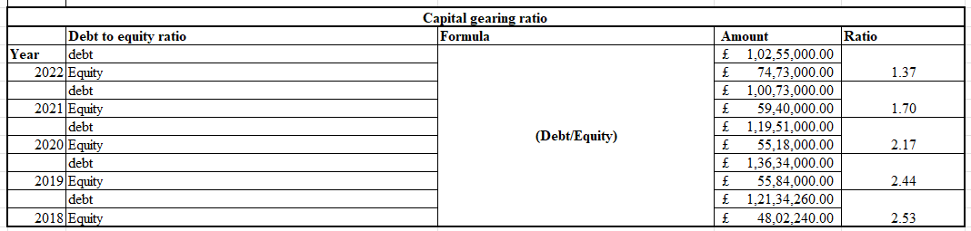
CAPITAL GEARING RATIO
Capital gain ratio evaluation has been calculated by debt to equity ratio which is present 2.53 times in the 2018
Debt to equity ratio evaluates Imperial brand operated business activity dependent on debt financing
Utilization of equity is less than debt financing that creates financial burden
Notes:
Capital gain ratio evaluation has been calculated by debt to equity ratio which is present 2.53 times in the 2018 financial year and 1.37 times in FY 2022. Debt to equity ratio evaluates Imperial brand operated business activity dependent on debt financing that consumes interest expenses. Utilization of equity is less than debt financing that creates financial burden on net profit volume.

Slide 7
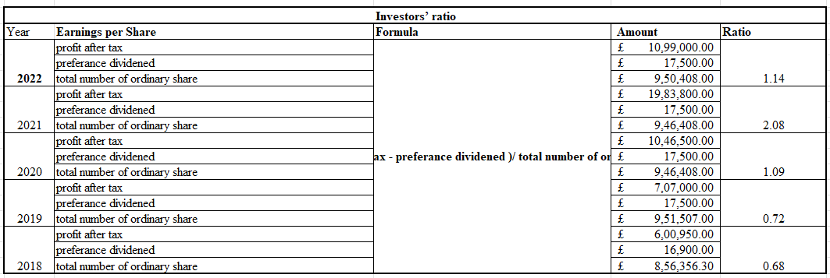
INVESTORS’ RATIO
Ratio has presented 0.68 in financial year 2018
It has been changed positively to 1.14 in financial year 2022 (Fridson & Alvarez, 2022)
Earning per share indicates organization equity price has been increased in the last 5 years
Notes:
Investors ratio has been calculated using Earning per share that presented investors' aspects in the last 5 years. This ratio has presented 0.68 in financial year 2018 which has been changed positively to 1.14 in financial year 2022 it evaluates investors could remain invested in this organization for positive results of the last 5 years (Fridson & Alvarez, 2022). Growth of Earning per share indicates organization equity price has been increased in the last 5 years that creates wealth for investors.

Slide 8
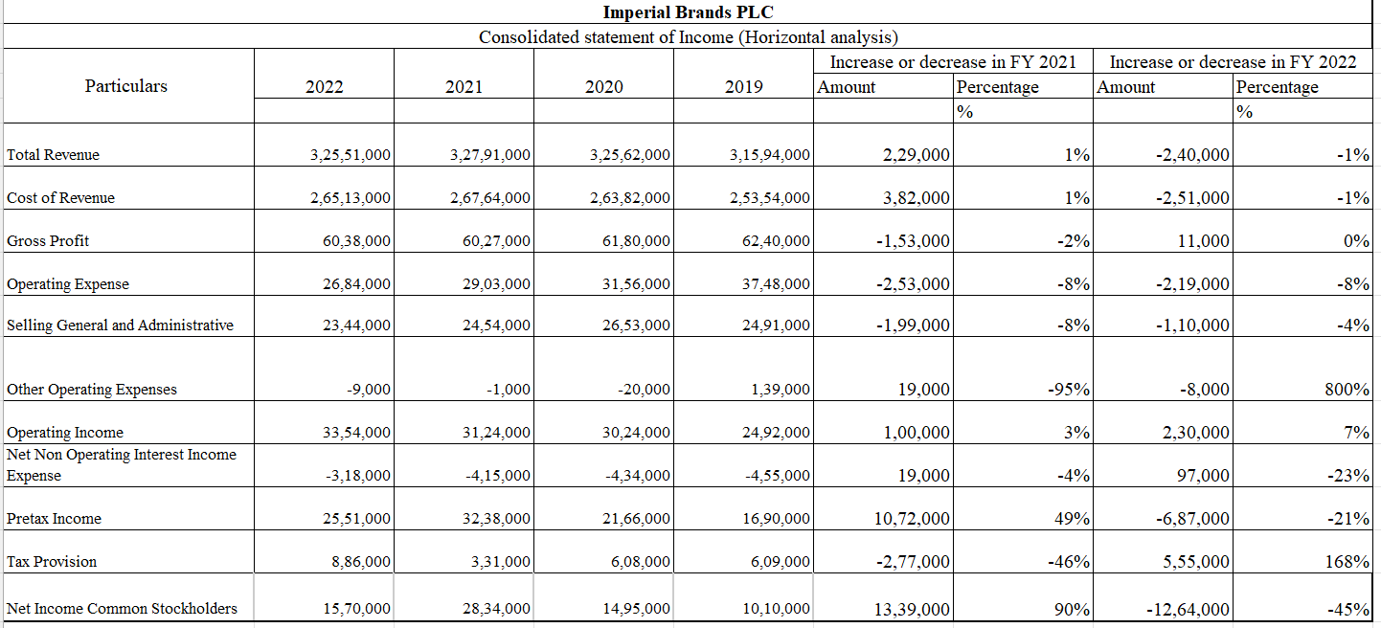
CONSOLIDATED STATEMENT OF INCOME (HORIZONTAL ANALYSIS)
Horizontal analysis has presented information regarding positive change in revenue and cost of revenue in financial year 2022 around 1%
Revenue and cost of revenue will increase by about 1% in fiscal year 2022 (Ginting, 2021)
Pretax Income has climbed by around 49%, and the gross profit margin deficit is expected to be -2% in the 2022 fiscal year
Notes:
Horizontal analysis has presented information regarding positive change in revenue and cost of revenue in financial year 2022 around 1%. Additional information has been derived about gross profit margin deficit -2% in financial year 2022 and pretax Income has been increased around 49%. Valuation of comparative analysis between growth and deficit between 2022 and 2021, revenue volume increased positively whereas gross and net profit fell down around -4%. According to statistics from a horizontal analysis, revenue and cost of revenue will increase by about 1% in fiscal year 2022 (Ginting, 2021). Pretax Income has climbed by around 49%, and the gross profit margin deficit is expected to be -2% in the 2022 fiscal year. Revenue volume increased positively while gross and net profit declined by almost 4% between 2022 and 2021, according to a comparative examination of growth and deficit

Slide 9
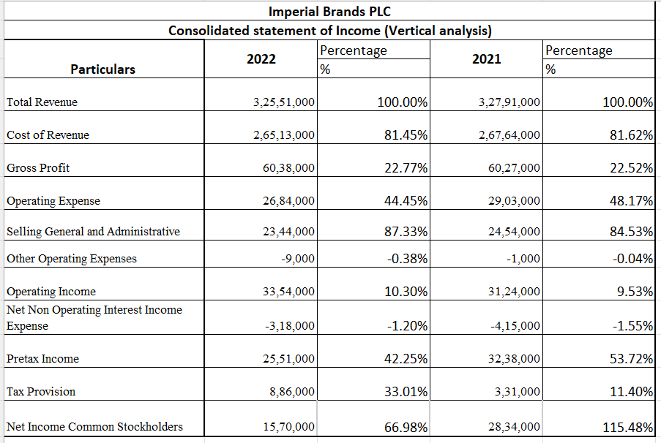
VERTICAL ANALYSIS
Vertical analysis presented 81.45% cost of revenue of financial year 2022
According to the comparative information, the gross profit margin has been increased based on revenue is 22.77%
It 81.62% in financial year 2021
Notes:
Vertical analysis presented 81.45% cost of revenue of financial year 2022 that was 81.62% in financial year 2021. According to the comparative information, the gross profit margin has been increased based on revenue is 22.77% in the financial year 2021. Vertical research showed that the cost of revenue for the fiscal year 2022 was 81.45% lower than it was for the fiscal year 2021 (81.62%)

Slide 10
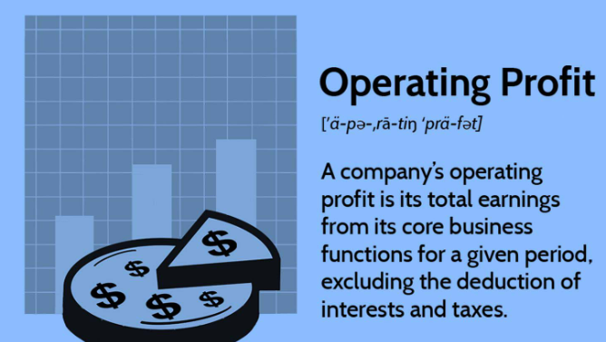
CONTD.
Gross-profit margin has improved and will be 22.77% based on revenue in fiscal year 2021 (Jahangir et al. 2021)
It also supplied data on the increase of gross profit
pretax income for the fiscal years 2022 and 2021, which are 42.25% and 53.72%
Notes:
According to comparison data, the gross-profit margin has improved and will be 22.77% based on revenue in fiscal year 2021 (Jahangir et al. 2021). Vertical analysis also offered data on pretax income for the fiscal years 2022 and 2021, which are 42.25% and 53.72%, respectively. It also supplied data on the increase of gross profit, which declined in the fiscal year 2022 (Pinha & Sagawa, (2020). Vertical analysis also provided information regarding pretax income of financial year 2022 and 2021 are 42.25% and 53.72% it presented information regarding growth of gross profit has fallen down in FY 2022.

Slide 11
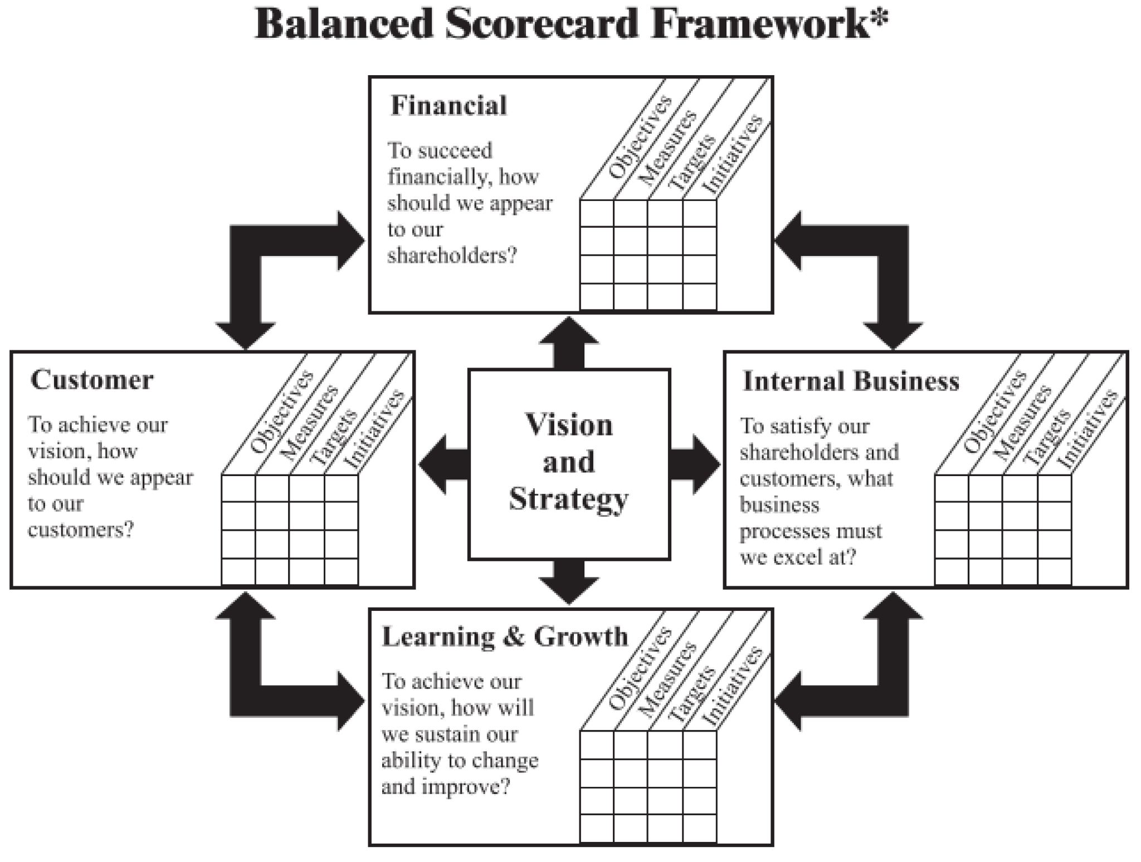
BALANCED SCORECARD
Positive ROCE growth has been interpreted as an investor engagement
It presents a possibility to gather capital for long-term business operation expansion (Janssens et al. 2021)
Imperial brand struggled to maintain enough growth in revenue volume to expand business operations continuously
Notes:
This rise has been hailed as a success for the organization's financial strategy and also gives it access to enough resources to support business expansion. Positive ROCE growth has been interpreted as an investor engagement that presents a possibility to gather capital for long-term business operation expansion (Janssens et al. 2021). Imperial brand struggled to maintain enough growth in revenue volume to expand business operations continuously,

Slide 12
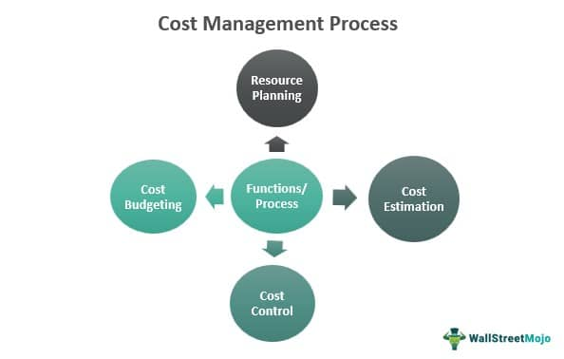
CONTD.
The organizational cost management strategies' ineffectiveness (Palepu et al. 2020)
Positive ROCE growth has been interpreted as an investor engagement
It presents a possibility to gather capital for long-term business operation expansion.
Notes:
Imperial brand struggled to maintain enough growth in revenue volume to expand business operations continuously, which required a sufficient cash input. The organizational cost management strategies' ineffectiveness in managing operational activity is also shown by the net profit margin, which affects net profit volume (Palepu et al. 2020). Positive ROCE growth has been interpreted as an investor engagement that presents a possibility to gather capital for long-term business operation expansion.

Slide 13
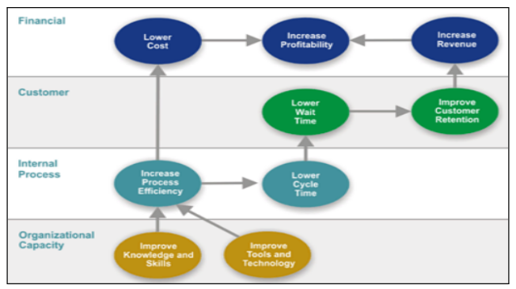
STRATEGY MAP
Equity is used less frequently than debt financing (Jin et al. 2021)
Productivity development puts less of a financial strain on net profit volume.
Customer engagement development by utilizing capital gains would be ineffective for operations and activity (Li et al. 2022)
Notes:
Using Cost reduction policies, financial resources optimization needs to be a prime objective in business planning. The debt to equity ratio assesses the debt-financed business activity under the Imperial brand that incurs interest costs. Equity is used less frequently than debt financing (Jin et al. 2021), Productivity development puts less of a financial strain on net profit volume. Customer engagement development by utilizing capital gains would be ineffective for operations and activity because debt financing makes customer engagement development difficult for operations and electrical activities to grow to their full potential because a significant amount of overall revenue has been used for interest expenditures rather than marketing expenses.

Slide 14
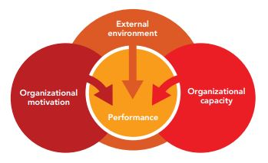
ENGAGEMENT AND REFLECTION OF GROUP WORK
Person 1
Capital gain regarding information has been reflected about financial resources importance
It needs to be balanced for long term sustainability of business operation
Total revenue has been utilized for interest expenses
Notes:
Capital gain regarding information has been reflected about financial resources importance in business operations which needs to be balanced for long term sustainability of business operation. Utilization of capital gain would not work effectively for operation and activity because debt Financing creates issues for sufficient growth in operation electrical activities because a major portion of total revenue has been utilized for interest expenses.

Slide 15
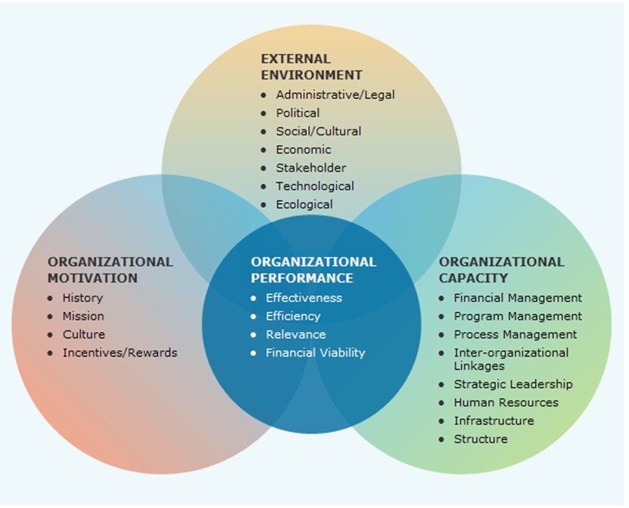
PERSON 2
organizational aspect has the ability to grow business operations with sustainable cost management
Positive growth in ROCE has been considered as an engagement of investors
it could be considered as deficit where management needs to focus on cash inflow for better return on capital employed establishment
Notes:
Return on capital employed evaluating optimization of total assets that could be provided information regarding the organizational aspect has the ability to grow business operations with sustainable cost management. Positive growth in ROCE has been considered as an engagement of investors that could be evaluated as an opportunity to collect financial resources for long term expansion of business operation. Last financial year 2022 return on capital employed has been identified as 30.47% it could be considered as deficit where management needs to focus on cash inflow for better return on capital employed establishment.

Slide 16
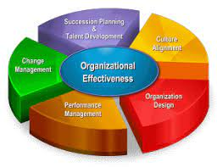
PERSON 3
ABC energy has potential for financial growth
stakeholders management implementation derives different stakeholders interest and influence
Business initiation has provided information of positive opportunity for business growt
Notes:
Financial aspect analysis of ABC energy business plan with sustainable planning of business initiation has provided information of positive opportunity for business growth. Additionally stakeholders management implementation derives different stakeholders interest and influence in business operations which are going to be considered by management to take action in business activity. It can be stated that a business plan regarding ABC energy has potential for financial growth with sustainable opportunity grainer in the comparative market.

Slide 17
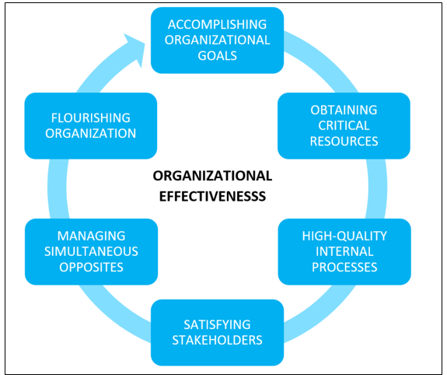
PERSON 4
Excessive consumption of debt impacts negatively profitability
Continuous progression of business activity required sufficient cash inflow
Imperial brand struggled to maintain sufficient growth in revenue volume
Notes:
Excessive consumption of debt impacts negatively on positives that have been evaluated by analysis because excessive interest expenses reduce ultimate profitability of Imperial brand. Continuous progression of business activity required sufficient cash inflow for growth of business operations where Imperial brand struggled to maintain sufficient growth in revenue volume.

Slide 18
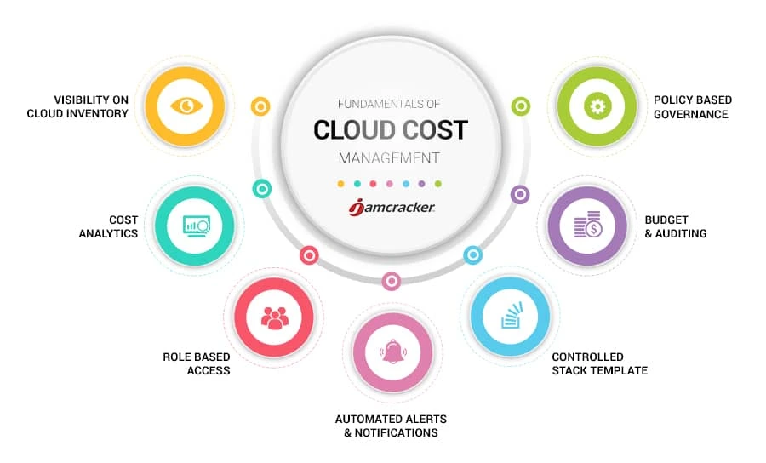
CONCLUSION AND RECOMMENDATION
Conclusion
It has been concluded based on ratio of current assets and liabilities present
lack of growth in the financial aspect where current asset volume growth is required
Equity is used less frequently than debt financing
Recommendation
Cost management and resource optimization plan required
Use of cost-cutting initiatives
Productivity growth places less of a financial impact on net profit volume
Notes:
Conclusion
It has been concluded based on ratio of current assets and liabilities present lack of growth in the financial aspect where current asset volume growth is required for long term sustainability. The fact that current assets have more information about the cash balance available than current liabilities could be viewed as a good financial development for the Imperial brand's capacity to carry on with operations. Current asset volume growth is necessary for long-term sustainability, however the ratio of current assets to liabilities shows lack of growth in the financial area. The debt to equity ratio assesses the debt-financed business activity under the Imperial brand that incurs interest costs. Equity is used less frequently than debt financing, which puts less of a financial strain on net profit volume.
Recommendation
Excess debt financing hinders operations and activity from expanding to their full potential by diverting a sizable portion of total revenue to interest payments rather than marketing expenses, sufficient customer engagement development through the use of capital gains might be ineffective for operations and activity.The use of cost-cutting initiatives and the optimisation of financial resources must be the main goals of corporate planning. The debt to equity ratio evaluates the Imperial brand's debt-financed business activity that incurs interest charges. Productivity growth places less of a financial impact on net profit volume since equity is employed less frequently than debt financing.

Slide 19
REFERENCE LIST
Chang, V., Li, T., & Zeng, Z. (2019). Towards an improved Adaboost algorithmic method for computational financial analysis. Journal of Parallel and Distributed Computing, 134, 219-232. https://www.sciencedirect.com/science/article/pii/S0743731518307068
Fisu, A. A., & Didiharyono, D. (2020, April). Economic & Financial Feasibility Analysis of Tarakan Fishery Industrial Estate Masterplan. In IOP Conference Series: Earth and Environmental Science (Vol. 469, No. 1, p. 012002). IOP Publishing. https://iopscience.iop.org/article/10.1088/1755-1315/469/1/012002/meta
Fridson, M. S., & Alvarez, F. (2022). Financial statement analysis: a practitioner's guide. John Wiley & Sons. https://www.tandfonline.com/doi/abs/10.1080/17538963.2021.1882064
Ginting, E. S. (2021). Ratio-Based Financial Performance Analysis of PT. Mustika Ratu, Tbk. Enrichment: Journal of Management, 11(2), 456-462. https://www.enrichment.iocspublisher.org/index.php/enrichment/article/view/124
Jahangir, M. H., Mokhtari, R., & Mousavi, S. A. (2021). Performance evaluation and financial analysis of applying hybrid renewable systems in cooling unit of data centers–A case study. Sustainable Energy Technologies and Assessments, 46, 101220. https://www.sciencedirect.com/science/article/pii/S2213138821002307
Janssens, W., Pradhan, M., de Groot, R., Sidze, E., Donfouet, H. P. P., & Abajobir, A. (2021). The short-term economic effects of COVID-19 on low-income households in rural Kenya: An analysis using weekly financial household data. World Development, 138, 105280. https://www.sciencedirect.com/science/article/pii/S0305750X20304071
Jin, X., Liu, Q., & Long, H. (2021). Impact of cost–benefit analysis on financial benefit evaluation of investment projects under back propagation neural network. Journal of Computational and Applied Mathematics, 384, 113172. https://www.sciencedirect.com/science/article/pii/S0377042720304635
Li, Z., Farmanesh, P., Kirikkaleli, D., & Itani, R. (2022). A comparative analysis of COVID-19 and global financial crises: evidence from US economy. Economic Research-Ekonomska Istraživanja, 35(1), 2427-2441. https://www.tandfonline.com/doi/abs/10.1080/1331677X.2021.1952640
Palepu, K. G., Healy, P. M., Wright, S., Bradbury, M., & Coulton, J. (2020). Business analysis and valuation: Using financial statements. Cengage AU. https://books.google.com/books?hl=en&lr=&id=IDT6DwAAQBAJ&oi=fnd&pg=PR13&dq=Financial+Analysis+&ots=uJip8Ywf9X&sig=2ob2b7G9RCK1mdofZveuOjYKVUg
Pinha, A. C. H., & Sagawa, J. K. (2020). A system dynamics modelling approach for municipal solid waste management and financial analysis. Journal of Cleaner Production, 269, 122350. https://www.sciencedirect.com/science/article/pii/S0959652620323970
Tao, R., Su, C. W., Yaqoob, T., & Hammal, M. I. R. (2022). Do financial and non-financial stocks hedge against lockdown in Covid-19? An event study analysis. Economic Research-Ekonomska Istraživanja, 35(1), 2405-2426. https://www.tandfonline.com/doi/abs/10.1080/1331677X.2021.1948881
Vogel, H. L. (2020). Entertainment industry economics: A guide for financial analysis. Cambridge University Press. https://books.google.com/books?hl=en&lr=&id=xozrDwAAQBAJ&oi=fnd&pg=PR19&dq=Financial+Analysis+&ots=EubSS3sdPD&sig=Ott1qZgZxl-vdkvClXchmoR2ED4
Finance.yahoo.com, 2023, Annual report of Imperial brand, https://finance.yahoo.com/quote/IMB.L/financials?p=IMB.L

Slide 20


